Slide 1

INTRODUCTION TO ORACLE, CLOUD & AGILE
02
03
01
Cloud Computing it’s Services and benifits
Enterprise Software
DBMS
04
05
06
Benifits of cloud computing
OCI and It’s architecture
Cloud Models

Slide 2
Oracle is a U.S.-based information technology company that offers a wide range of business-oriented products and services that include Oracle Database, a relational database management system (RDBMS). The company was founded in 1977 in California and is among the largest software and hardware companies in the world. Renowned for its robust database management systems and cloud infrastructure solutions.Offers a wide range of software applications used by businesses worldwide especially in 2010 it started on cloud Transformation.
Enterprise Software: Enterprise software is designed to help large organizations manage and streamline their operations.
It helps organizations run efficiently by automating tasks, managing data, and facilitating communication across different departments.
.
Example: Salesforce is a cloud-based Customer Relationship Management (CRM) platform. It helps companies manage customer interactions, sales, and data

Slide 3
Oracle Cloud Services:
Compute Services
Storage Services
Networking Services
Database Services
Security Services
Developer Services
Observability and Management Services

Slide 4
DBMS
A DBMS is software that allows users to create, manage, and manipulate databases.
Used to efficiently store, retrieve, and manage data in databases.
Amazon Using Oracle Database:
Amazon needed a robust and scalable database system to handle vast amounts of product data, customer information, and transaction records.
So, they implemented Oracle Database, a powerful RDBMS, to manage its e-commerce operations.
Oracle Products: Java, MySQL, Linux, NoSQL

Slide 5
Cloud Computing & Benifits with Real Time Example
Instead of owning and maintaining your own computer hardware and software, you use resources provided by a third party over the internet.
These resources can range from simple storage to complex computing power.
Benifits: Cost-Effective, Scalable, Accessible, Fast & Agile, Secure, Innovative, Eco-Friendly:
Examples of cloud computing:
Email: Gmail, Outlook
Office Suites: Google Docs, Microsoft 365
Video Streaming: Netflix, YouTube
Online Gaming: Many online games rely on cloud servers.

Slide 6
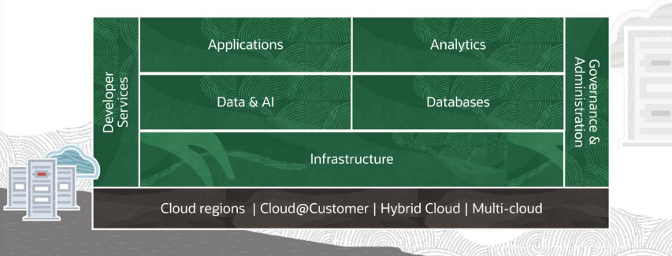
OCI and It’s Archiecture
Oracle Cloud Infrastructure (OCI) is a cloud computing platform offered by Oracle. It provides a wide range of services, including compute, storage, networking, database, and more. it as a virtual data center where you can rent computing resources like servers, storage, and software without having to manage the physical hardware.

Slide 7
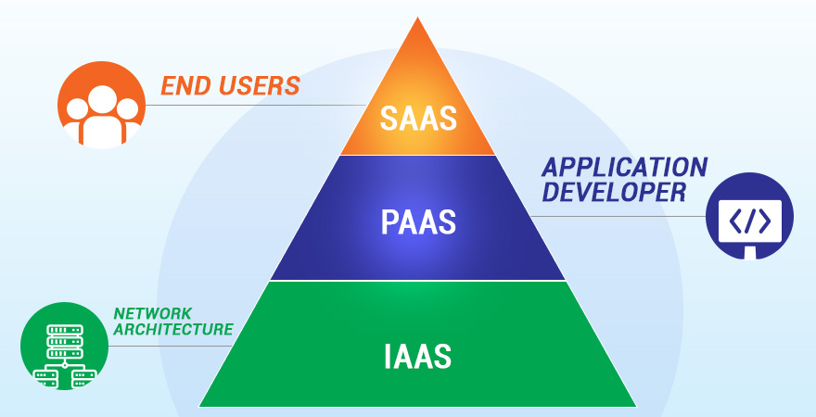
Cloud Models:
Three primary cloud models:
Infrastructure as a Service (IaaS)
Platform as a Service (PaaS)
Software as a Service (SaaS)
1. Infrastracture as a Services:
Provides virtualized computing resources over the internet.Users manage OS, applications, and data; providers manage hardware and networking.
Common use cases:
Hosting virtual machines
Scalable storage solutions
Disaster recovery solutions
Examples: Amazon EC2, Microsoft Azure VMs, Oracle Cloud Infrastructure (OCI) Compute

Slide 8
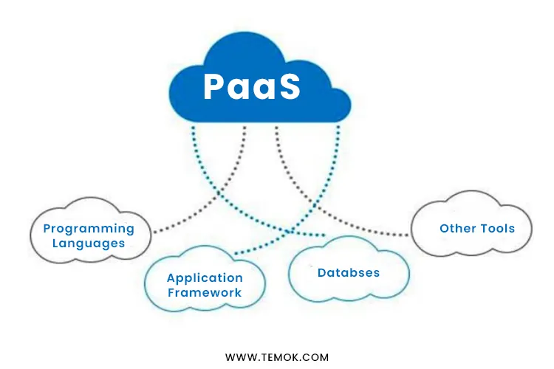
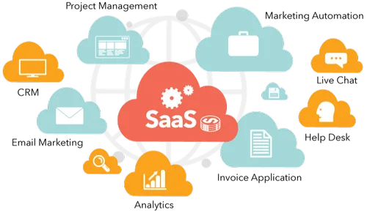
2. Platform as a Services:
Provides a complete development and deployment environment.Users focus on building applications; the provider manages underlying infrastructure.
Common use cases:
Application development & deployment
API management
Database management
Examples: Oracle APEX, Google App Engine, Microsoft Azure App Services.
3. Software as a Services:
Delivers software applications over the internet on a subscription basis.
Users only interact with the application; providers manage everything else.
Common use cases:
Email & collaboration tools
CRM & ERP systems
File storage & sharing
Examples: Google Workspace, Microsoft 365.

Slide 9
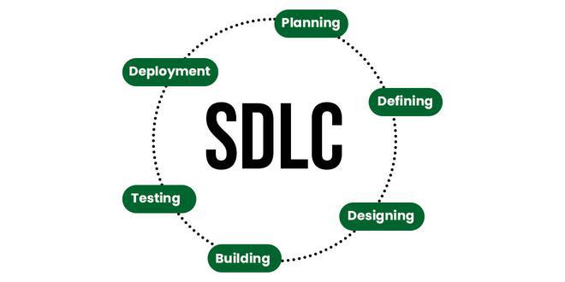
Introduction to Agile
SDLC Life Cycle
Agile is a project management and software development approach focused on iterative progress.
It emphasizes flexibility, customer collaboration, and continuous improvement.
Common Agile frameworks: Scrum, Lean, XP.
Reason for Choosing Agile:
Faster and more efficient project delivery.
Encourages adaptability and responsiveness to change.
Enhances collaboration and communication among teams.
Focuses on delivering value to custome
Your Title Here
Presentations are communication tools that can be used as demonstrations, lectures, speeches, reports, and more. Most of the time, they're presented before an audience.
Project 3
Project 1
Project 2
.

Slide 10
Scrum and it’s need
Scrum is an agile framework for developing and delivering complex products.
It emphasizes teamwork, accountability, and iterative progress toward a well-defined goal.
Used in software development but applicable to other industries.
Key Principle of Scrum
Transparency – Work progress is visible to all stakeholders.
Inspection – Regular check-ins and adaptations ensure continuous improvement.
Adaptation – Adjustments are made based on feedback and changes in requirements.

Slide 11
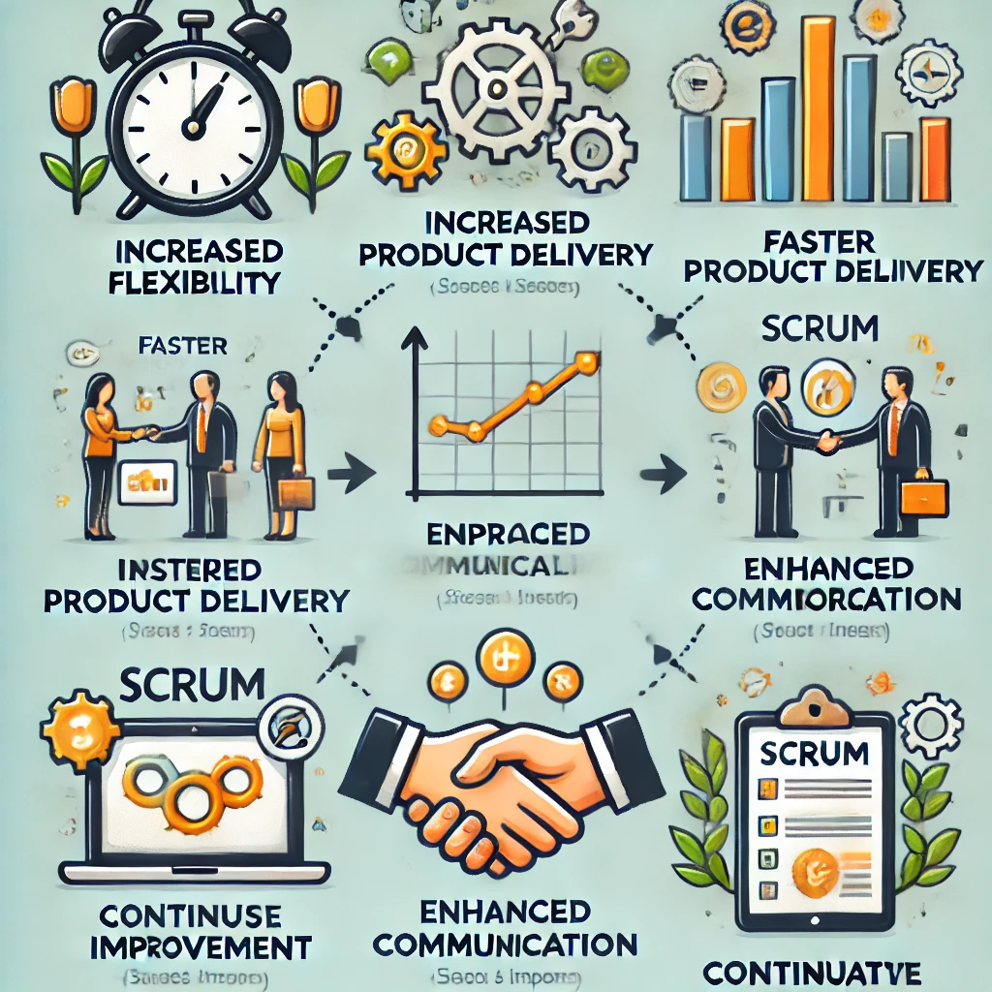
Benifits of Scrum
Increased flexibility and adaptability.
Faster delivery of high-quality products.
Improved collaboration and communication.
Continuous improvement through feedback.

Slide 12
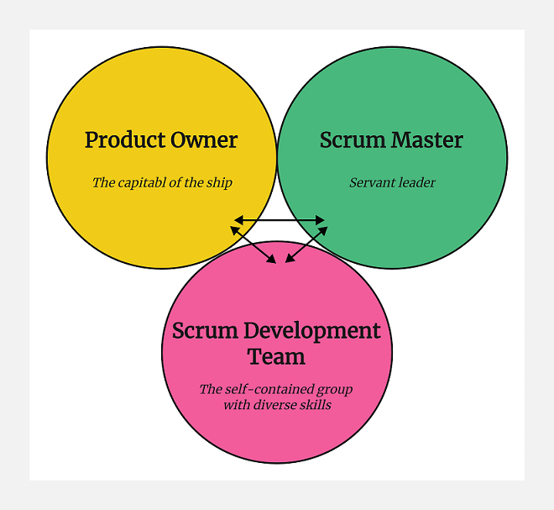
Scrum Roles
Product Owner: Defines product vision and prioritizes backlog items.
Scrum Master: Facilitates Scrum process and removes obstacles.
Development Team: Cross-functional team that delivers product increments

Slide 13
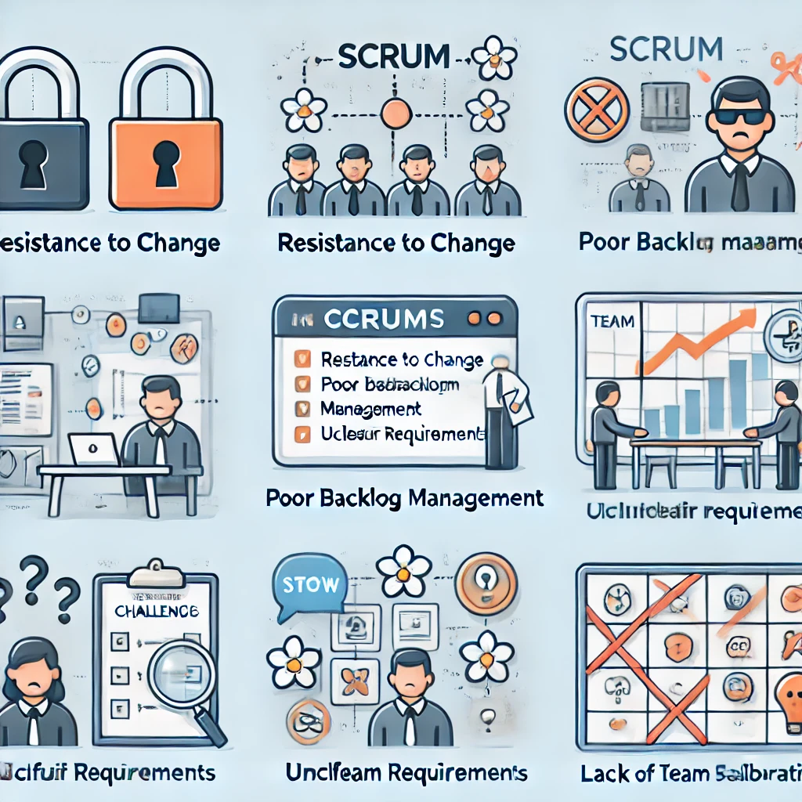
Common Challenges in Scrum
Resistance to change.
Poor backlog management.
Incomplete or unclear requirements.
Lack of team collaboration.
Over all summary about Scrum
Scrum enables agile project management with iterative development.
Key roles: Product Owner, Scrum Master, Development Team.
Events and artifacts ensure transparency and continuous improvement.
Next Steps: Start applying Scrum in your projects!

Slide 14
Thankyou
Trainer: Praveenkumar P

